Slide 1
Skilled Technical Workforce:
Supply, Demand, and Pathways
Data Science for the Public Good
Summer 2019
Alyssa Fowers, Sarah McDonald, and Calvin Isch
Vicki Lancaster, Ph.D., Sam Cohen, Ph.D.
Notes:
Someone needs to download, go into Master, and change where the slide # goes on no footer slides; they don't align. Please also make a blank outline one for our graphs.

Slide 2
Data Science for the Public Good Skilled Technical Workforce (STW) Team
NCSES | John Finamore | Program Director, Human Resources Statistics Program
UVA | Alyssa Fowers | Data Science for the Public Good Fellow
UVA | Calvin Isch | Data Science for the Public Good Intern
UVA | Sarah McDonald | Data Science for the Public Good Intern
UVA | Vicki Lancaster | Principal Scientist
UVA | Samantha Cohen | Postdoctoral Research Associate
UVA | Devika Nair | Research Scientist
UVA | Nathaniel Ratcliff | Assistant Research Professor

Slide 3
What is the Skilled Technical Work (STW)?
A job in the STW requires*:
A high level of knowledge in a technical domain; but
Does not require a bachelor’s degree for entry.
Skilled Technical Work:
Is critical to the nation’s ability to innovate and compete in the global economy; and
Can be a pathway for the individual to the middle class.
*Rothwell JT, (September 1, 2015) Skilled Technical Work (September 1, 2015). Available at SSRN: https://ssrn.com/abstract=2709141 or http://dx.doi.org/10.2139/ssrn.2709141
Notes:
In this project, we're using the Rothwell definition of skilled technical work. We applied that to a more recent version of the Occupation Information Network (or O*NET) database to identify skilled technical work occupations
VICKY WILL DO IT
Vicki's comments:
-Rothwell reference
ADD A BULLET TO NO CURRENT DATA
CHANGE TITLE TO WHY STUDY STW?
DELETE TABLE, HAVE BOX POP UP AFTER WITH NO INFO ON THIS
PIC OF NSB REPORT WITH NO INFO
Add the data science framework
Sallie – why is NCSES looking into this – no current data on this
Stephanie -- n
EXAMPLES OF SKILLED TECHNICAL PROFESSIONS INSTEAD OF THIS GRAPH
If you're not going to explain graph, remove it. It's not essential to your point. Instead, just give some examples of skilled technical world FIELDS and PROFESSIONS
This graph makes me ask lots of questions—are these just jobs that don't require a bachelor's degree?
If you want to talk about this graph and Rothwell, you can say he idnetified these positions, but how can we leverage that knowledge to ensure these positions are filled?
Larger axes and labels, minimize text
This isn't the same title font as other slides.

Slide 4

Why study the STW?
More precise understanding can lead to policy reforms that enhance the economic well-being of both the nation and individual.
“Better data and better analyses of data are needed to make progress in understanding and addressing the challenges of skilled technical workforce development.”
National Academies report, Building America's Skilled Technical Workforce (2017)
Notes:
A non-degree credential includes work experience programs (i.e., apprenticeships), licenses & certifications, and certificates (i.e., nanodegrees, microcredentials, etc.) that do not result in a college (bachelor's, master's or doctoral) or professional degree.
ADD A BULLET TO NO CURRENT DATA
CHANGE TITLE TO WHY STUDY STW?
DELETE TABLE, HAVE BOX POP UP AFTER WITH NO INFO ON THIS
PIC OF NSB REPORT WITH NO INFO
Add the data science framework
Sallie – why is NCSES looking into this – no current data on this
Stephanie -- n
EXAMPLES OF SKILLED TECHNICAL PROFESSIONS INSTEAD OF THIS GRAPH
If you're not going to explain graph, remove it. It's not essential to your point. Instead, just give some examples of skilled technical world FIELDS and PROFESSIONS
This graph makes me ask lots of questions—are these just jobs that don't require a bachelor's degree?
If you want to talk about this graph and Rothwell, you can say he idnetified these positions, but how can we leverage that knowledge to ensure these positions are filled?
Larger axes and labels, minimize text
This isn't the same title font as other slides.

Slide 5
Why study the STW?
Currently there are no federal surveys that measure the prevalence and pathways to non-degree credentials.
Notes:
This research uses the Burning Glass Technologies (BGT) job-ad and resume data, identified in our Data Discovery process, to fillin this data gap.
A non-degree credential includes work experience programs (i.e., apprenticeships), licenses & certifications, and certificates (i.e., nanodegrees, microcredentials, etc.) that do not result in a college (bachelor's, master's or doctoral) or professional degree.
DELETE TABLE, HAVE BOX POP UP AFTER WITH NO INFO ON THIS
PIC OF NSB REPORT WITH NO INFO
Add the data science framework
Sallie – why is NCSES looking into this – no current data on this

Slide 6
Research Questions
What are the most in-demand skilled technical occupations in Virginia?
Can we evaluate the match between demand and supply for skills in the STW?
What pathways besides a 4-year degree will provide the skills necessary to secure a job in the STW?
Notes:
Can we understand skills form these data sources – data useful? Is there existing data to answer these questions?
Can we evaluate match between demand and supply?
Vicki's comments
-delete first one
-want a proof of concept of supply, and demand – can we understand supply and demand within these two msa's,require linking them
-next steps

Slide 7
Proof of Concept
Can we use "existing" data to understand the skills needed for in-demand skilled technical occupations, and how those compare to the skills available in the local labor force?
Notes:
Can we understand skills form these data sources – data useful? Is there existing data to answer these questions?
Can we evaluate match between demand and supply?
Vicki's comments
-delete first one
-want a proof of concept of supply, and demand – can we understand supply and demand within these two msa's,require linking them
-next steps

Slide 8
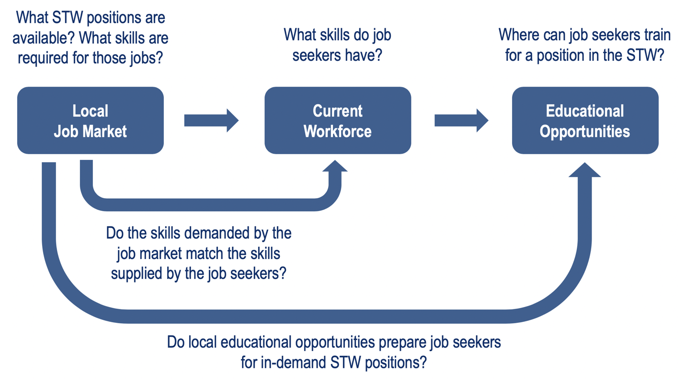
Notes:
Can we understand skills form these data sources – data useful? Is there existing data to answer these questions?
Can we evaluate match between demand and supply?
Vicki's comments
-delete first one
-want a proof of concept of supply, and demand – can we understand supply and demand within these two msa's,require linking them
-next steps

Slide 9
Describing the Local Job Market With Online Job-Ads
What STW positions are
available? What skills are required for those jobs?
Local
Job Market
Current Workforce
Educational Opportunities

Slide 10

* https://www.burning-glass.com/about/
Notes:
WE HAVE PURCHASED THE DATA

Slide 11
50,000
sites daily
70
variables
2007,
2010-19
* https://www.burning-glass.com/about/

Slide 12
50,000
sites daily
70
variables
2007,
2010-19
MSA
O*NET Code
Education
Skills Requested
* https://www.burning-glass.com/about/
Notes:
MSA- metropolitan statistical area -- core area containing a substantial population nucleus, together with adjacent communities having a high degree of economic and social integration with that core.
US Census and US Office of Management and Budget
O*NET is like a job-id alyssa will give the definition earlier
Program by department of labor – primary source of occupational info

Slide 13
Known Data Bias
50,000
sites daily
70
variables
2007,
2010-19
Skewed toward jobs with higher levels of education
* https://www.burning-glass.com/about/
Notes:
Mention our technical document, add citation if possible

Slide 14
Augmentations of Job-Ad Data

Slide 15


Augmentations of Job-Ad Data
1. STW Jobs
Rothwell STW Parameters
Notes:
Rothwell (2015)
High technical experience
Majority of workers do not have Bachelor's degree
ONET department of labor – nations primary source of occupational info.

Slide 16
Augmentations of Job-Ad Data
1. STW Jobs 2. Hard/Soft Skills
Rothwell STW Parameters
Notes:
A "soft skill" is personality-based, primarily used to interact with coworkers, or a general way of approaching a problem.
communication
A "hard skill" requires domain-specific knowledge or can be easily measured and evaluated.
"Microsoft Excel"
"Bayesian Statistics"

Slide 17
Augmentations of Job-Ad Data
A "soft skill" is personality-based, primarily used to interact with coworkers, or a general way of approaching a problem.
"Teamwork"
"Creativity"
A "hard skill" requires domain-specific knowledge or can be easily measured and evaluated.
"Microsoft Excel"
"Bayesian Statistics"

Slide 18
Augmentations of Job-Ad Data
1. STW Jobs 2. Hard/Soft Skills
Rothwell STW Parameters
Define Hard/Soft Skills
STW Jobs of Interest
Notes:
A "soft skill" is personality-based, primarily used to interact with coworkers, or a general way of approaching a problem.
communication
A "hard skill" requires domain-specific knowledge or can be easily measured and evaluated.
"Microsoft Excel"
"Bayesian Statistics"

Slide 19
Augmentations of Job-Ad Data
1. STW Jobs Changes 2. Hard/Soft Skills 3. Skill Changes
Rothwell STW Parameters
Define Hard/Soft Skills
Identify
'near-duplicate'
skills
STW Jobs of Interest
Group together
Notes:
Neonatal intensive care unit (NICU) vs Neonatal intensive care unit

Slide 20
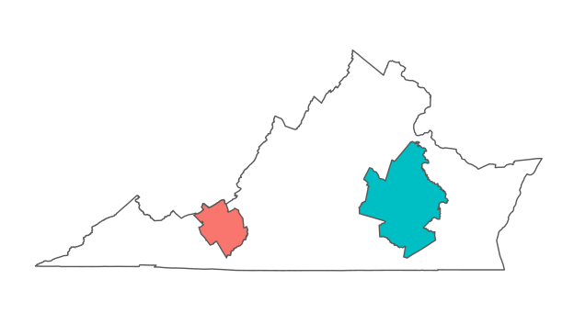
Focus on Richmond and Blacksburg
Selected two metropolitan statistical areas (MSAs) in
2016-17:
Richmond
(Population 1,292,911)
Blacksburg-Christiansburg-Radford
(Population 182,692)
Job-ads and MSAs Used for Analysis
https://factfinder.census.gov/faces/tableservices/jsf/pages/productview.xhtml?src=bkmk
Notes:
Completely contained within Virginia,
“Quarantined” from each other by distance
LMI report about how they're different
Doing the years to 2016-17 bc of resume data
- We don't want to do different analyses, we want to see differences between towns of varied size.

Slide 21
Common STW Jobs in our MSAs
Blacksburg (2,119 STW)
11.6% Critical Care Nurses
9.4% Computer User Support Specialists
6.9% Maintenance and Repair Workers, General
2.1% Emergency Medical Technicians and Paramedics
2.0% Automotive Specialty Technicians
Richmond (18,598 STW)
8.7% Critical Care Nurses
7.5% Maintenance and Repair Workers, General
5.6% Computer User Support Specialists
3.2% Automotive Specialty Technicians
2.7% Web Developers
Notes:
Roth well definition applied to a DATASET.
SAY EACH ONE OUT LOUD

Slide 22
Common STW Jobs in our MSAs
Blacksburg (2,119 STW)
11.6% Critical Care Nurses
9.4% Computer User Support Specialists
6.9% Maintenance and Repair Workers, General
2.1% Emergency Medical Technicians and Paramedics
2.0% Automotive Specialty Technicians
Richmond (18,598 STW)
8.7% Critical Care Nurses
7.5% Maintenance and Repair Workers, General
5.6% Computer User Support Specialists
3.2% Automotive Specialty Technicians
2.7% Web Developers
Selected Critical Care Nurses (CCN) for a case study

Slide 23
Ads for Critical Care Nurses in Richmond and Blacksburg
All Virginia job ads, 2016-2017: 1,486,697
All Richmond job ads:
205,285
All Blacksburg job ads:
24,358
STW Richmond job ads:
18,598
STW Blacksburg job ads:
2,119
Critical Care Nurse ads in Richmond:
1,609
Critical Care Nurse ads in Blacksburg:
245
All Richmond resumes: 91,885
All Blacksburg-Christiansburg-Radford resumes: 10,423
15
Notes:
Vicki's comment – add a schematic and more information about how hard it was
Add a step to filter to STW (WHAT PERCENT ARE STW)
Overall 123,862 STW Ads 8.3%

Slide 24
Ads for Critical Care Nurses in Richmond and Blacksburg
All Virginia job ads, 2016-2017: 1,486,697
Filter By MSA
Filter By MSA
All Richmond job ads:
205,285
All Blacksburg job ads:
24,358
Filter via O*NET and Bachelor’s Requirement
Filter via O*NET and Bachelor’s Requirement
STW Richmond job ads:
18,598
All Blacksburg job ads:
2,119
Filter By O*NET Again
Filter By O*NET Again
Critical Care Nurse ads in Richmond:
1,609
Critical Care Nurse ads in Blacksburg:
245
All Richmond resumes: 91,885
All Blacksburg-Christiansburg-Radford resumes: 10,423
15
Notes:
Vicki's comment – add a schematic and more information about how hard it was
Add a step to filter to STW (WHAT PERCENT ARE STW)
Overall 123,862 STW Ads 8.3%

Slide 25
Describing the Current Workforce with Online Resumes
What STW positions are
available? What skills are required for those jobs?
What skills do job
seekers have?
Local
Job Market
Current Workforce
Educational Opportunities

Slide 26
BGT Resume Data
BGT proprietary dataset, sourced from Burning Glass partners.
Benchmarked against BLS data for age, education, resume address, and SOC occupation (Schubert, Stansbury, & Taska (2019))
Notes:
SKILLS ARE ALSO CANONICALIZED BY BGT so it allows for easy comparisons, less refined
Unclear if other individuals besides BGT have used this.
This slide needs to be practiced so it is cleaner: Write up how you merged/cleaned for use after project ends.
Did BGT only collect data from 2016-2018, or is that all you focused on?
How the files were merged, commonalities with BGT Job Ads
How do we know the numbers on the files didn't matter?
Motivate: we overcame some significant challenges with this data by.........

Slide 27
BGT Resume Data
BGT proprietary dataset, sourced from Burning Glass partners.
Originally 2200 zipped files; merged into 5 unique data-tables:
Personal information, skills, education, certifications, job history
Benchmarked against BLS data for age, education, resume address, and SOC occupation (Schubert, Stansbury, & Taska (2019))
Notes:
SKILLS ARE ALSO CANONICALIZED BY BGT so it allows for easy comparisons, less refined
Unclear if other individuals besides BGT have used this.
This slide needs to be practiced so it is cleaner: Write up how you merged/cleaned for use after project ends. Did BGT only collect data from 2016-2018, or is that all you focused on?
How the files were merged, commonalities with BGT Job Ads
How do we know the numbers on the files didn't matter?
Motivate: we overcame som significant challenges with this data by.........

Slide 28
BGT Resume Data
BGT proprietary dataset, sourced from Burning Glass partners.
Originally 2200 zipped files; merged into 5 unique data-tables:
Personal information, skills, education, certifications, job history
Analyzed two MSAs using 2016-17resume data:
Benchmarked against BLS data for age, education, resume address, & SOC occupation (Schubert, Stansbury, & Taska (2019))
Blacksburg:
10,428
Richmond:
91,916

Slide 29
Connecting Ads to Resumes With Burning Glass Skills Data
Local
Job Market
Current Workforce
Educational Opportunities
Do the skills demanded by the job market match the skills supplied by the job seekers?
Notes:
Shouldn't just do every resume to every ad.

Slide 30
Identifying Plausible Candidates for STW: Critical Skills
Identify critical skills: hard skills in over 25% of job ads
Excluding extremely common hard skills, e.g. "Teaching"
Select resumes with at least one critical skill
Notes:
Skills that identify plausible candidates for a job
WE DIDN'T IGNORE SOFT SKILLS FOR MATCHING, WE JUST DIDN'T USE THEM TO DEFINE WHO A CANDIDATE IS. ALL SKILLS IN MATCH ANALYSIS!
XX Check Teaching Examples

Slide 31
Identifying Plausible Candidates for STW: Critical Skills
Identify critical skills: hard skills in over 25% of job ads
Excluding extremely common hard skills, e.g. "Teaching"
Select resumes with at least one critical skill
Critical Skills:
Richmond: Critical Care, Advanced Cardiac Life Support, Patient Care, and Neonatal Intensive Care Unit
Blacksburg: Critical Care, Advanced Cardiac Life Support, Patient Care
Notes:
Skills that identify plausible candidates for a job
WE DIDN'T IGNORE SOFT SKILLS FOR MATCHING, WE JUST DIDN'T USE THEM TO DEFINE WHO A CANDIDATE IS. ALL SKILLS IN MATCH ANALYSIS!
XX Check Teaching Examples

Slide 32
Ads for Critical Care Nurses in Richmond and Blacksburg
Critical Care Nurse candidates in Richmond:
3,150
Critical Care Nurse candidates in Blacksburg:
266
Has one or more core CCN skill
Has one or more core CCN skill
All Richmond
resumes:
91,885
All Blacksburg-Christiansburg-Radford resumes:
10,423
All Resumes with no job activity in 2018:
102,308 for both MSAs
22

Slide 33
Ads for Critical Care Nurses in Richmond and Blacksburg
All Virginia job ads, 2016-2017: 1,486,697
All Richmond job ads: 205,285
All Blacksburg job ads: 24,358
STW Richmond job ads: 18,598
All Blacksburg job ads: 2,119
Critical Care Nurse ads in Richmond: 1,609
Critical Care Nurse ads in Blacksburg: 245
Critical Care Nurse candidates in Richmond: 3,150
Critical Care Nurse candidates in Blacksburg: 266
Has one or more core CCN skill
Has one or more core CCN skill
All Richmond resumes: 91,885
All Blacksburg-Christiansburg-Radford resumes: 10,423

Slide 34
Ads for Critical Care Nurses in Richmond and Blacksburg
All Virginia job ads, 2016-2017: 1,486,697
All Richmond job ads: 205,285
All Blacksburg job ads: 24,358
STW Richmond job ads: 18,598
All Blacksburg job ads: 2,119
Critical Care Nurse ads in Richmond: 1,609
Critical Care Nurse ads in Blacksburg: 245
Critical Care Nurse candidates in Richmond: 3,150
Critical Care Nurse candidates in Blacksburg: 266
Has 1+ core CCN skill
Has one or more core CCN skill
Has one or more core CCN skill
Has 1+ core CCN skill
All Richmond resumes: 91,885
All Blacksburg-Christiansburg-Radford resumes: 10,423

Slide 35
All Virginia job ads, 2016-2017: 1,486,697
….....
….....
Critical Care Nurse ads in Richmond:
1,609
Critical Care Nurse ads in Blacksburg:
245
Critical Care Nurse candidates in Richmond:
3,150
Critical Care Nurse candidates in Blacksburg:
266
….....
….....
All Resumes with no job activity in 2018:
102,308 for both MSAs
All Richmond resumes: 91,885
All Blacksburg-Christiansburg-Radford resumes: 10,423
15
Notes:
Vicki's comment – add a schematic and more information about how hard it was
Add a step to filter to STW (WHAT PERCENT ARE STW)
Overall 123,862 STW Ads 8.3%

Slide 36
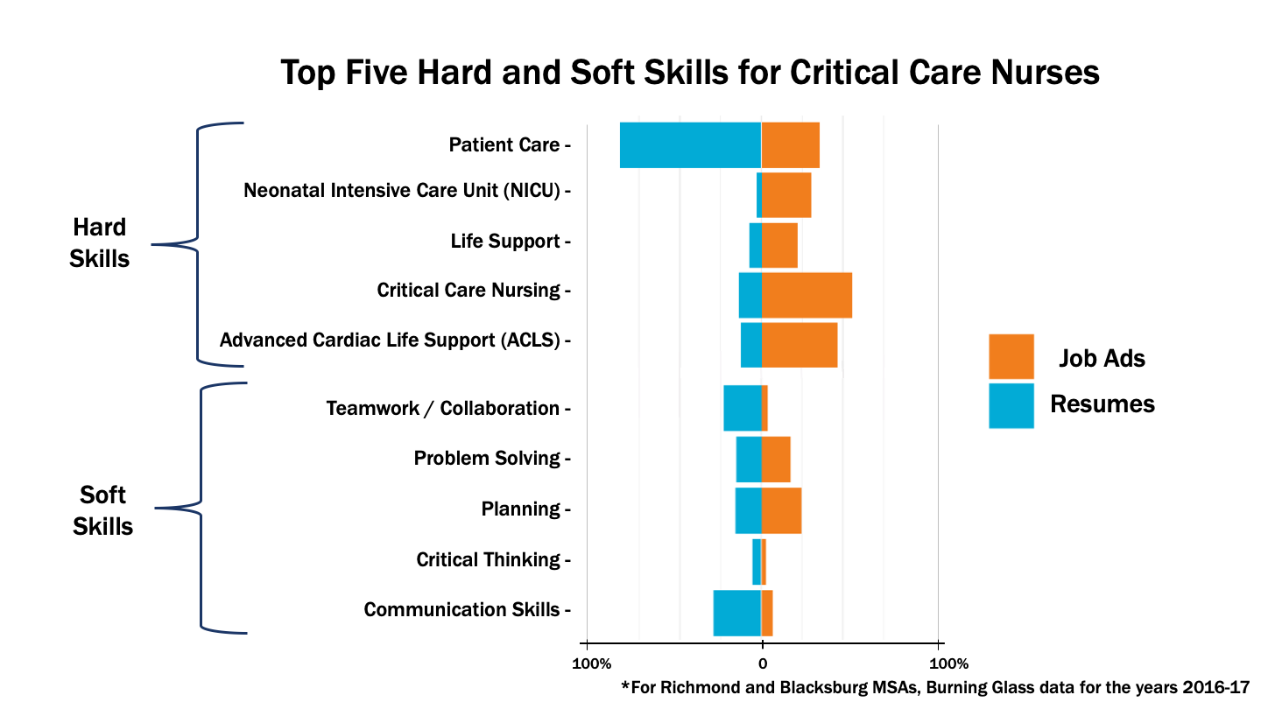
Skill Differences Between Job Ads and Resumes
Most hard skills are undersupplied
Most soft skills are oversupplied.
Some skills appear to be extremely undersupplied (NICU)
Notes:
WHILE WE DIDN’T SELECT ON SOFT SKILLS WE ALLOWED THEM TO BE IN FOR COMPARISON – STILL OVERSUPPLIED
Here, take a second, and explain your axes. The x axis is the proportion of job ads (in orange) or resumes (blue) on the top five hard and soft skills. Point to each bar as you explain it—if you look at Patient Care here, almost all candidates have that skill, but it's mentioned in under 50% of ads.
Note that this across MSAs

Slide 37

Determining Match Between Ads and Resumes
Sample Resume
Life Support | Trauma | NICU | Patient Care
Proportion of requested skills fulfilled by resume
Match With Ad
 | Life Support | Trauma | NICU | Patient Care | Matching Skills | # of Skills Requested | Match Score
Job 1
Job 2
Job 3
Job 4
1
2
0.5
3 | 3 | 1
0 | 1 | 0
3 | 4 | 0.75
Skills Listed On Resume
 | Life Support | Trauma | NICU | Patient Care
Job 1
Job 2
Job 3
Job 4
 | Life Support | Trauma | NICU | Patient Care
Resume 1
 | Life Support | Trauma | Neonatal Intensive Care Unit | Patient Care
Resume 1
Resume 2
Resume 3
Resume 4
 | Life Support | Trauma | Neonatal Intensive Care Unit | Patient Care
Ad 1
Ad 2
Ad 3
Ad 4
Notes:
MOTIVATE why you are talking about mismatch. So we know the employers want these skills, and the potential employees have these other set of skills. How can we compare them? We could look at them individually, like above, but different jobs require different combinations. So we came up with a way to measure this "match"
we look at every job, and the individual skills it required, and calculate the proportion of the requested skills each candidate. Make sure to go through each, not just Job 1. "Job 3 only wants NICU, which our candidate doesn’t have, so they have 0 of the 1 skills asked for—0)
BTW if you're thinking like a statistician, we did 2 matrixes, one for skilll prescence in job ads, and another for resumes, and did simple matrix multiplication (do not just say "we made matrices and multipled them—you need to see what that matrix is.
SALLIE REMIND THEM THAT BY NORMALIZING YOU'RE COUNTING FOR NUMBER OF SKILL REQUIREMENT VARIANCE
SIMPLE WEIGHTING SCHEME THAT CAN BE ADJUSTED
You can see here that this candidate, who has a lot of skills, actually has a wide variety in her match score to the various positions.....I
XX Fix animations.

Slide 38
Determining Match Between Ads and Resumes
Sample Resume
Life Support | Trauma | NICU | Patient Care
1 | 1 | 0 | 1
Match With Ad
 | Life Support | Trauma | NICU | Patient Care | Matching Skills | # of Skills Requested | Match Score
Job 1
Job 2
Job 3
Job 4
 | 1 | 0 | 1 | 0 | 1 | 2 | 0.5
 | 1 | 1 | 0 | 1 | 3 | 3 | 1
 | 0 | 0 | 1 | 0 | 0 | 1 | 0
 | 1 | 1 | 1 | 1 | 3 | 4 | .75
Skills Listed On Resume
 | Life Support | Trauma | NICU | Patient Care
Job 1
Job 2
Job 3
Job 4
 | Life Support | Trauma | NICU | Patient Care
Resume 1
 | Life Support | Trauma | Neonatal Intensive Care Unit | Patient Care
Resume 1
Resume 2
Resume 3
Resume 4
 | Life Support | Trauma | Neonatal Intensive Care Unit | Patient Care
Ad 1
Ad 2
Ad 3
Ad 4
Notes:
Matrix.

Slide 39
Determining Match Between Ads and Resumes
The skills requested in each ad were compared to the skills listed on each resume, resulting in a match score for each resume and each job.
 | Job 1 | Job 2 | Job 3 | Job 4
Resume 1 | 0.5 | 1 | 0 | .75
Resume 2 | 0 | .33 | 0 | .25
Resume 3 | 1 | .67 | 1 | .75
Resume 4 | .5 | 0 | 1 | 0
In Richmond, we matched 3,150 resumes to 1,609 job ads across 38 skills.
Notes:
STEPHANIE - ITS ALMOST A MATCH SCORE—MORE MISMATCH THAN MATCH
Put actual numbers of jobs, resumes, skills on slide
MOTIVATE why you are talking about mismatch.
So we know the employers want these skills, and the potential employees have these other set of skills. How can we compare them? We could look at them individually, like above, but different jobs require different combinations. So we came up with a way to measure this "mismatch"
The explanation here did not make much sense, and I want you guys to focus hard on making it work. It's pretty simple to say we look at every job, and the individual skills it required, and calculate the proportion of the requested skills each candidate has, instead of relying on only matrix algebra. You can still say say this is a table of all skills by all jobs, with a 1 whenever a job requests a skill. Then this is the same, but for resume skills instead of job skills. Then we multipled. So mismatch is the proportion of skill requested by a job that a candidate can provide.
Let's say it requires 5 skills. We then compare the skills listed in the resume of each candidate to those 5 skills. Here, Resume one has 2 of the 5 skills—so 40% of the requested skills, so Resume 1's mismatch score on Job 1 is .4. We repeat for each resume and each job, giving us a distribution of mismatch from 0 to 1 for each job ad.
Put this on a white background, looks bad with white of photos.
Explain both matrix algebra and practical example.

Slide 40
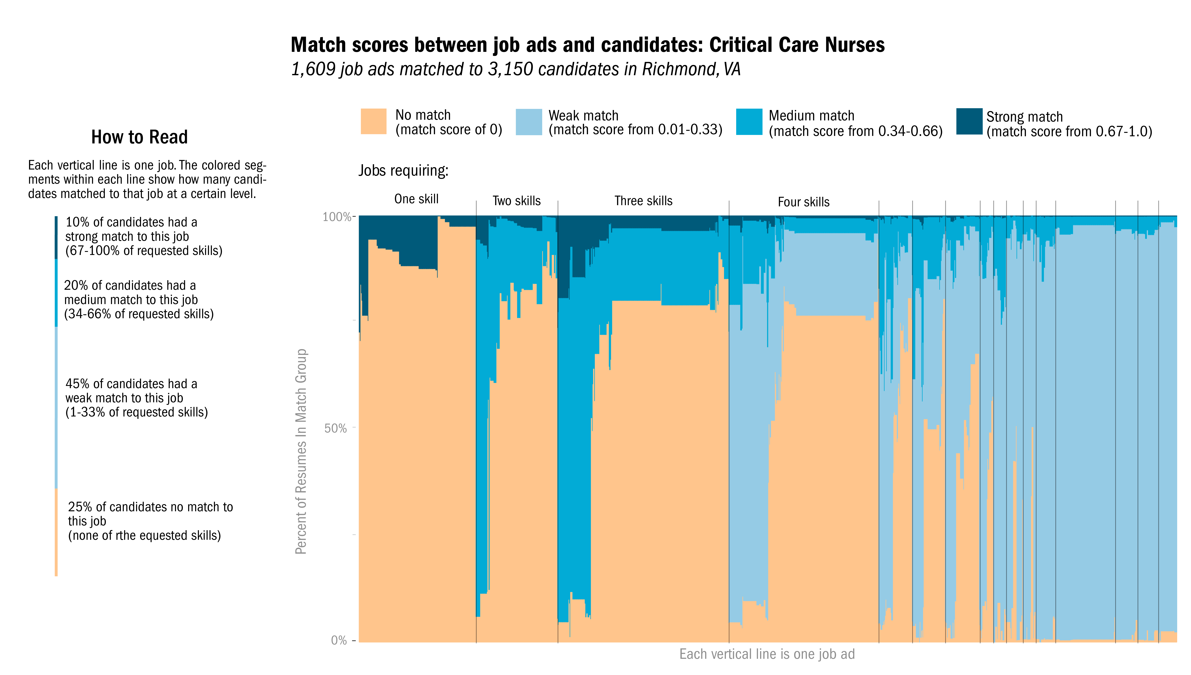
Notes:
There is a lot of variation in match across jobs, because each job asks for different skills in different combinations. So our next step was finding what skills were most needed.
Note on the x axis—there is no order. This is a stacked bar plot, for each job, where each vertical bar is a job. Sorted by # of skills required by job and then median job score.
Specific notes to make—orange is 0%---disjointed. Blue means its filled, and the darker the blue, the better the fit.
Slow down and explain the axis, then the colors, point to the bars. Hold off on your example until then
"There are a lot of jobs where the vast majority of resumes have none of the skils requested., esp. If there aren't many skills requesteed.
Emphasize that there is undersupply
These jobs look different!!! They have different distributions of match scores, even though they pull from the same pool of candidates!!! So that means the jobs are different from each other. So how do we know what skills are most needed.

Slide 41
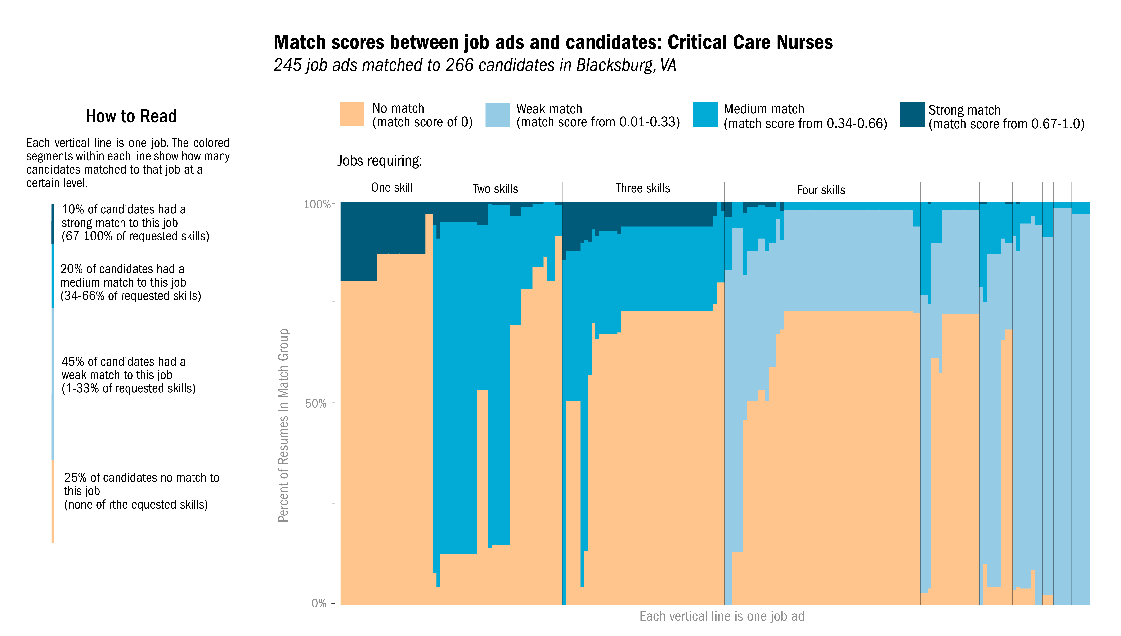
Notes:
Similar diversity of match scores in Blacksburg. Tends to ask for fewer skills in general.

Slide 42
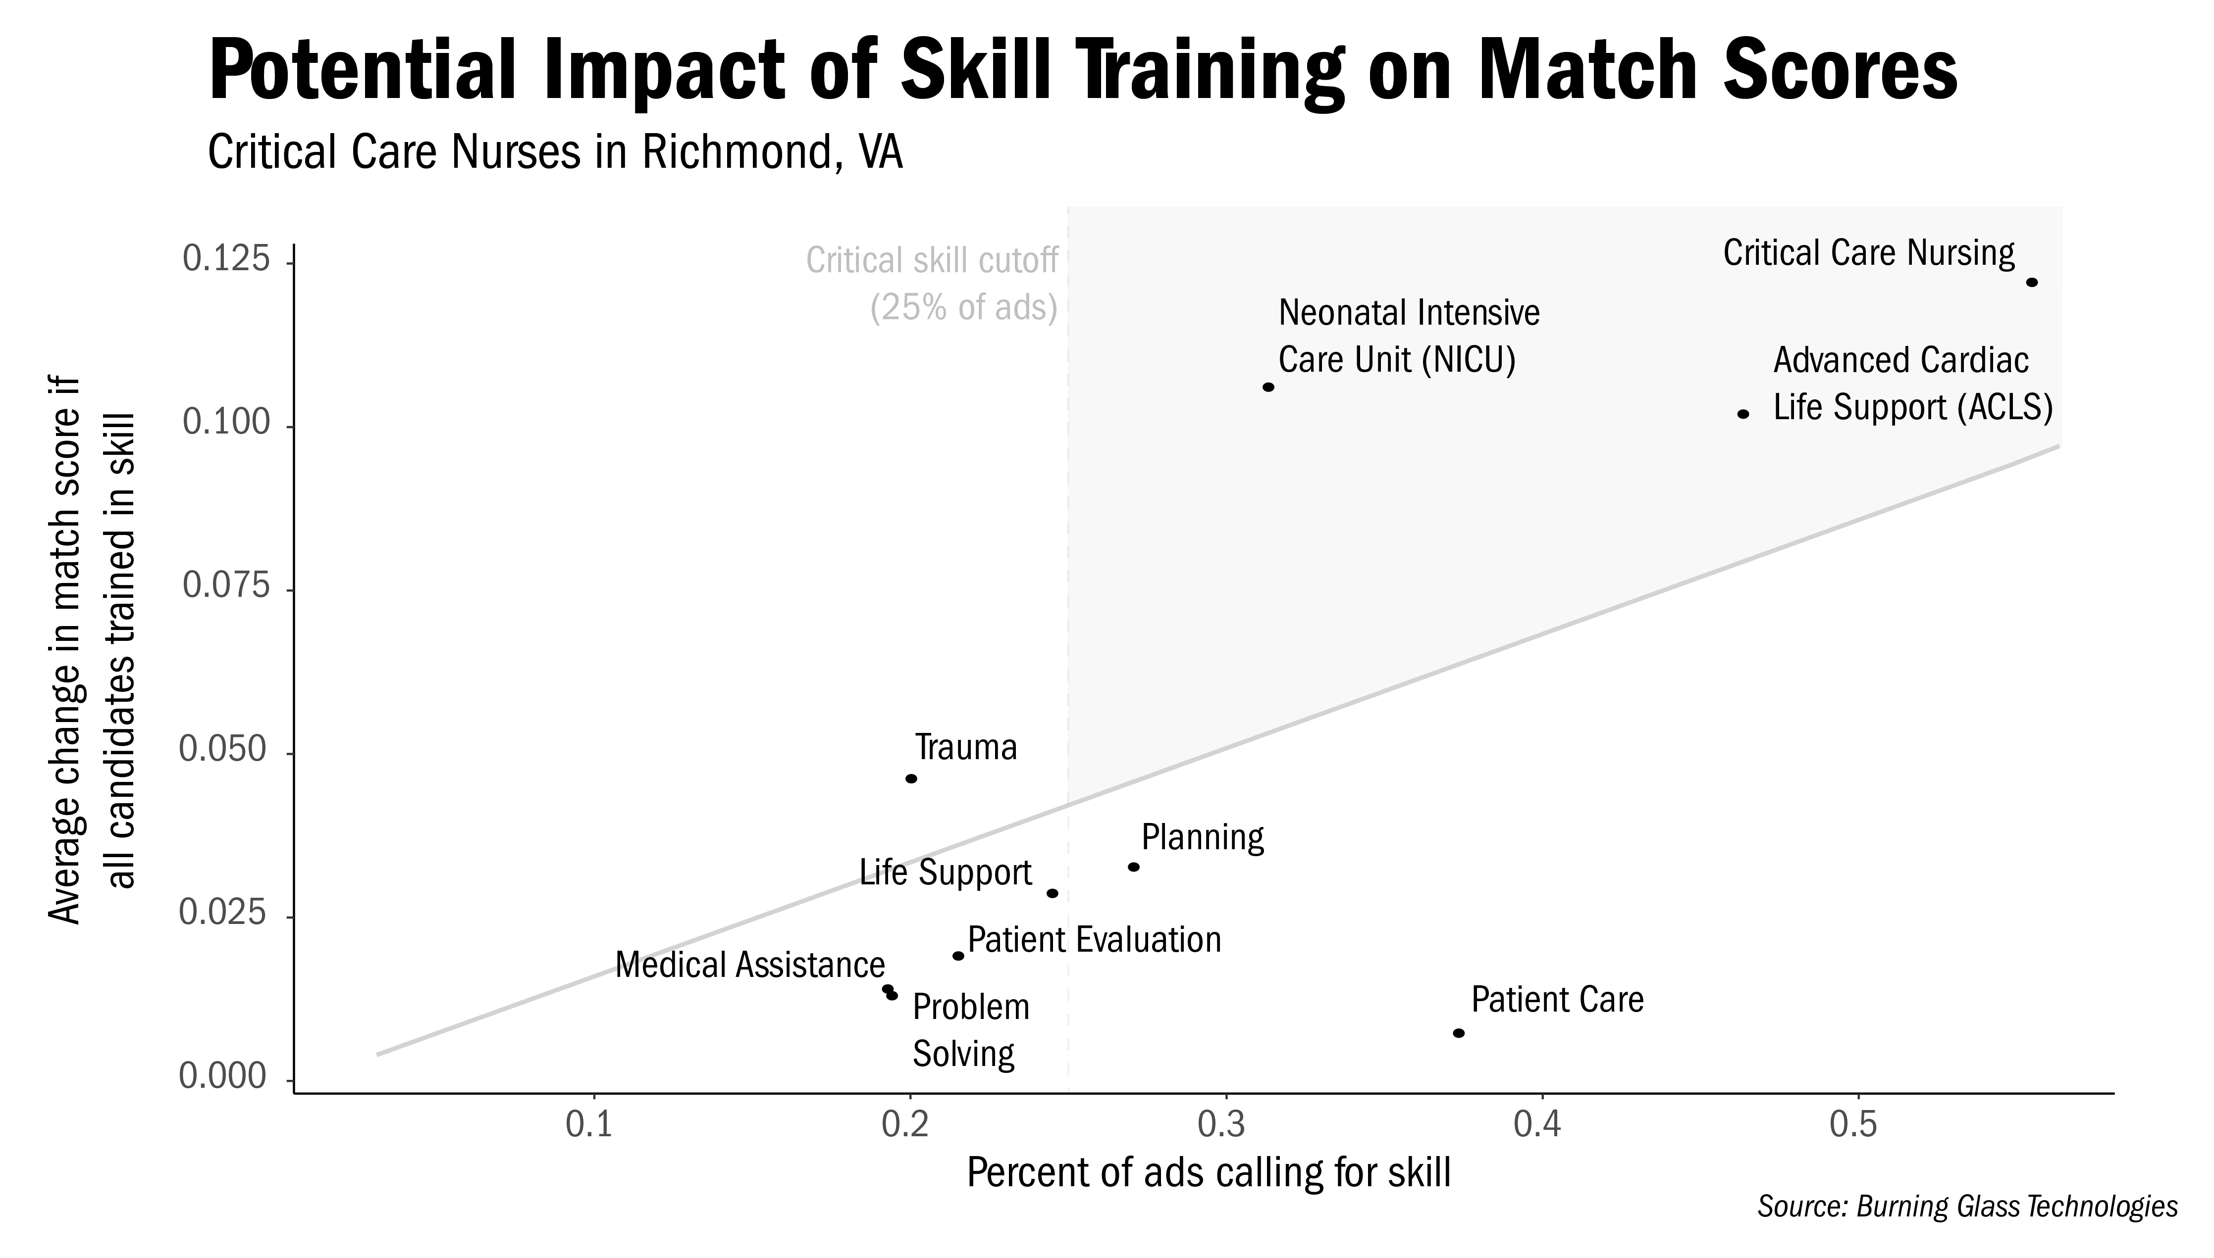
Notes:
EXPLAIN HOW YOU CALCULATED AVERAGE CHANGE (BY GIVING EVERYONE THE SKILL)
-PATIENT CARE IS NOT A DISCRIMINATOR
-PLANNING AND PROBLEM SOLVING

Slide 43
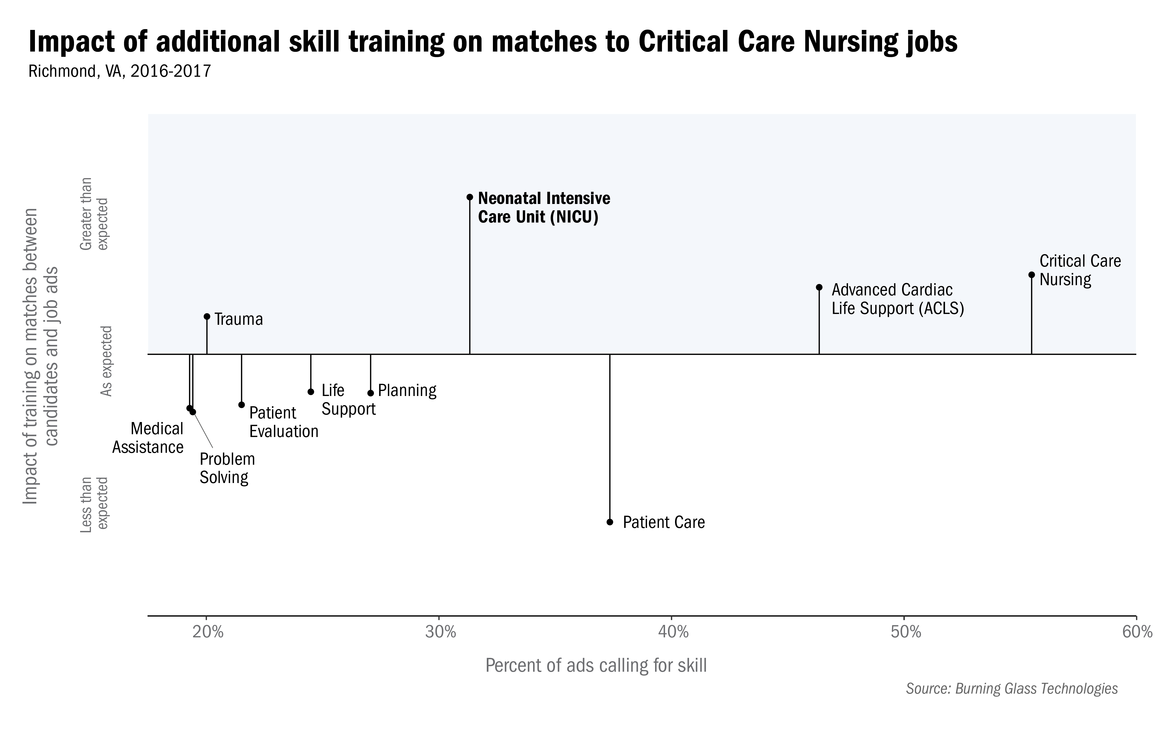
Notes:
SALLIE THINKS TAKE OUT THE COLORS, ADD STANDARD DEVIATIONS
Went skill by skill, and recalculated the match scores for each person so that they had that skill. Y is the change in the match score if suddenly all the candidates had that skill.
NOT that we don't need that skill or that we have enough of it, but that we are well-trained and most have it.
Clarify here that we are including soft skills.

Slide 44
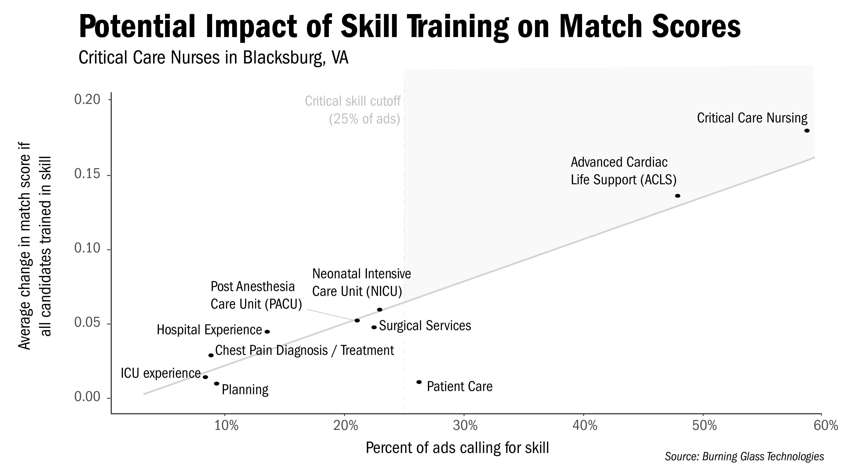
BLACKSBURG
Notes:
CCN candidates in Blacksburg don't have a huge standout skill that's missing. However, if you recall, there are many fewer potential candidates in Blacksburg than in Richmond: 245 for 266 jobs, compared to Richmond, where there are nearly twice as many potential candidates as positions. (Of course, we don't know if these are all the CCN jobs and all the CCN candidates—just what's posted online. However, does indicate that Richmond and Blacksburg have different challenges: Richmond needs nurses trained in particular skills, while Blacksburg needs to train or attract more nurses in general.)
So the question becomes: how can we train people in specific skills like NICU, or to become CCN in general?

Slide 45
Next Steps: Investigating Local Educational Opportunities
Where can job seekers train for a position in the STW?
Local
Job Market
Current Workforce
Educational Opportunities
Notes:
Now we want to connect the important skills from the previous analysis, such as Critical care nurse and Neonatal intensive unit, to the educational opportunities in theMSAs

Slide 46
Next Steps: Investigating Local Educational Opportunities
Apprenticeships
Certificate programs
Traditional Education
Associate's degrees
Local
Job Market
Current Workforce
Educational Opportunities
Non-Traditional Education
Notes:
When we look at educational opportunties, there are two routes, traditinal education and non-traditional education
Non-traditional education includes opportunities like coding bootcamps that programmers may take, so this does not really apply to critical care nurses

Slide 47
Critical Care Nurse Certifications
Critical Care Nurse Certification (CCRN)
American Association of Critical-Care Nurses
Must be a Registered Nurse (RN)
Must be in direct care of acutely/critically ill patients for designated years and hours
Take exam (Adult, Pediatric, Neonatal)
Cost: $239, $344
Neonatal Intensive Care Nursing (RNC-NIC)
National Certification Corporation
Must be a Registered Nurse (RN)
Must have Neonatal Intensive experience (direct patient care, education, administration, or research) for designated years and hours
Take exam
Cost: $325
Notes:
Two relevant certifications for skills from the previous analysis...

Slide 48

Associate’s Degree in Nursing Programs
State Council of Higher Education for Virginia (SCHEV)
Degree Inventory for public and private non-profit Institutions
For-profit degree offerings manually searched
Notes:
THis is a map of VA showing where in each MSA a potential candidate can receive an associates level degree in a program leading to NCLEX certification
The data for public institutions and private non profits is from SCHEV, which also provides a list of for-profits in VA
We then manually searched each for-profit within our MSAs to see what degrees they offer
It is also worth mentioning that there are additional opportunities to become a critical care nurse in neighboring roanoke, so a future step could be to investigate the radius of educational opportunities rather than opportunities within an MSA

Slide 49
Investigating Local Educational Opportunities
Apprenticeships
Certificate programs
Traditional Education
Associate's degrees
Local
Job Market
Current Workforce
Educational Opportunities
Massively open online courses
Non-Traditional Education
Coding bootcamps
Certifications
Notes:
Other educational opportunities, note the limits of the current approach

Slide 50
Apprenticeships
Certificate programs
Traditional Education
Associate's degrees
Local Job Market
Current Workforce
Educational Opportunities
Non-Traditional Education
Do the skills demanded by the job market match the skills supplied by the job seekers?
Do local educational opportunities prepare job seekers for in-demand STW positions?
Notes:
Here, just recap method, recap results on conclusion slides.
Additional notes: Look at neonatal intensive care training opportunities as well. Josh wants to know mismatch in skills on other job types.

Slide 51
Broad Conclusions
We have developed a match metric for skill supply and demand
There is an undersupply of resumes that match job ads in Critical Care Nursing
Skills needed are different in different MSAs
Both MSAs and surrounding areas have educational opportunities to become a Registered Nurse
Notes:
MAYBE CALL BACK TO THE SUPPLY
Animations here
, skills are better aligned in Blacksburg
Practice this slide!
Maybe say that, because the formal educational opportunities are available, we should be encouraging people to
If we want to say theres an undersupply, that needs to be made a point prior in the presentation.

Slide 52

Next Steps
Complete analysis for entire state and multiple careers
Link with the BGT education and credential data to compare candidates with different levels of education
Find a repeatable method for exploring certifications and non-traditional educational pathways
Explore the pathways of current skilled technical workers in resumes

Slide 53



Features of the Job Ad Dataset
Desired Credentials
Degree, Min & Max
Experience, Min & Max
Desired Skills
BGT skill hierarchy, Clusters & Cluster Families
Highly Cleaned
BGT Indicators for Baseline, Specialized, Software skills
Job Details:
MSA
O*NET code
Date posted
Salary
Employer
Career and Job Type
Hours

Slide 54
Finding A Probable STW: Education Level
Education
Non-homogenous data
Multiple degrees per entry, skewed distribution
"Some college"

Slide 55
Finding A Probable STW: Education Level
Cleaning
Institution:
High schools and military schools
Virginia community colleges
Technical and vocational schools
Degree type:
GED
Associates of multiple kinds
Major or degree type:
"Some college"
"Coursework"

Slide 56
Finding A Probable STW: Education Level
Cleaning
Institution:
High schools and military schools
Virginia community colleges
Technical and vocational schools
Degree type:
GED
Associates of multiple kinds
Major or degree type:
"Some college"
"Coursework"
Increased maximum
education level by 11% to 79%

Slide 57
Finding A Probable STW: Education Level
Education threshold:
Less than an Associate's
No education listed
Some college excluded
New variable: "Has Bachelor's"

Slide 58

Features of the Resume Dataset
Education/
Certifications:
Institution
Degree Level
Date
Major
Skills:
Clusters
Cluster Families
Highly Cleaned
Job History:
Employer
Dates
Position title
Personal Information:
Number of degrees
Candidate Location: city, state, county, zip-code, MSA

Slide 59
Thank You!

Slide 60
Extra Slides

Slide 61
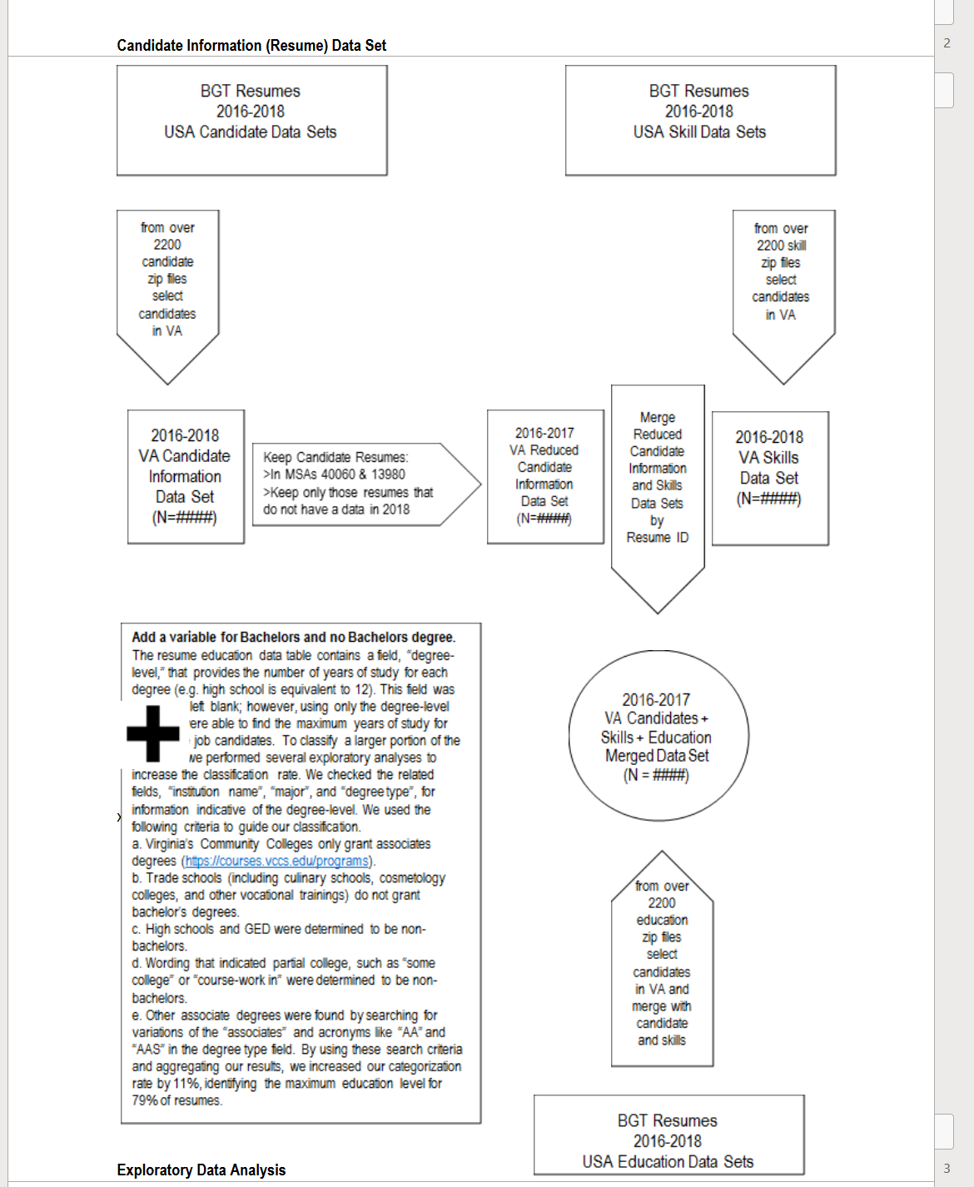
Summary: Resume Data Pipeline

Slide 62
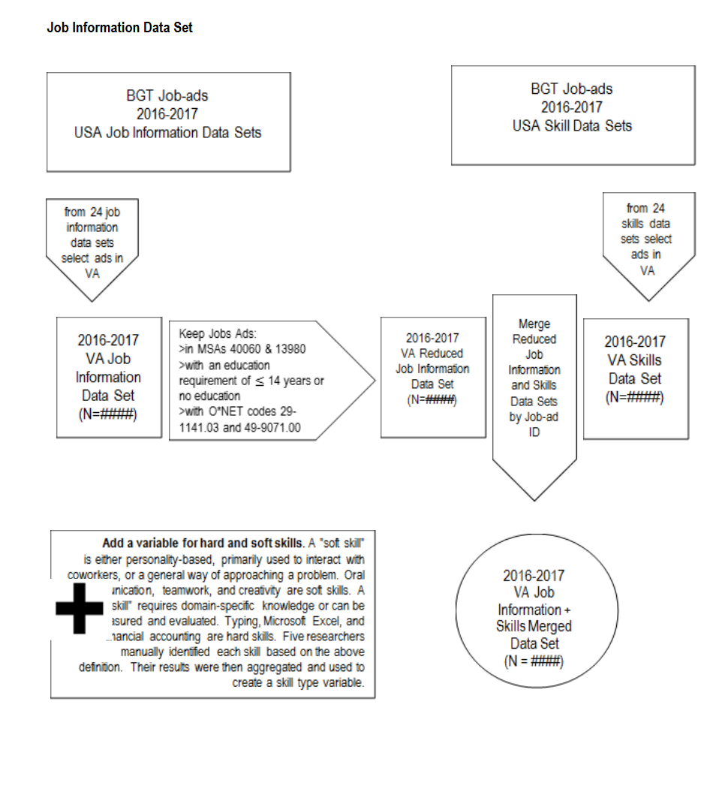
Summary: Job-Ads Data Pipeline

Slide 63
Ads for Critical Care Nurses in Richmond and Blacksburg
All Virginia job ads, 2016-2017: 1,486,697
Filter By MSA
Filter By MSA
All Richmond job ads:
205,285
All Blacksburg job ads:
24,358
Filter via O*NET and Bachelor’s Requirement
Filter via O*NET and Bachelor’s Requirement
STW Richmond job ads:
18,598
All Blacksburg job ads:
2,119
Filter By O*NET Again
Filter By O*NET Again
Critical Care Nurse ads in Richmond:
1,609
Critical Care Nurse ads in Blacksburg:
245
All Richmond resumes: 91,885
All Blacksburg-Christiansburg-Radford resumes: 10,423
15
Notes:
Vicki's comment – add a schematic and more information about how hard it was
Add a step to filter to STW (WHAT PERCENT ARE STW)
Overall 123,862 STW Ads 8.3%

Slide 64
Ads for Critical Care Nurses in Richmond and Blacksburg
Critical Care Nurse candidates in Richmond:
3,150
Critical Care Nurse candidates in Blacksburg:
266
Has one or more core CCN skill
Has one or more core CCN skill
All Richmond resumes:
91,885
All Blacksburg-Christiansburg-Radford resumes:
10,423
All Resumes with no job activity in 2018:
XX
22

Slide 65
All Virginia job ads, 2016-2017: 1,486,697
….....
….....
Critical Care Nurse ads in Richmond:
1,609
Critical Care Nurse ads in Blacksburg:
245
Critical Care Nurse candidates in Richmond:
3,150
Critical Care Nurse candidates in Blacksburg:
266
….....
….....
All Resumes with no job activity in 2018:
XX
All Richmond resumes: 91,885
All Blacksburg-Christiansburg-Radford resumes: 10,423
15
Notes:
Vicki's comment – add a schematic and more information about how hard it was
Add a step to filter to STW (WHAT PERCENT ARE STW)
Overall 123,862 STW Ads 8.3%

Slide 66
Data Pathways
Which jobs qualify as skilled technical work?
What skills are
required for local STW positions?
What skills do employers need?
Skilled Technical Worker definition (Rothwell)
Job Ads
(Burning Glass)
O*NET codes
What skills are missing from the workforce?
Do local educational opportunities match the local job market?
BGT skills classifications
CIP codes
CIP codes
Are there opportunities to gain missing skills and credentials?
Educational Opportunities (SCHEV and VCCS)
Resumes
(Burning Glass)
What skills do job seekers already have?
How can job seekers gain new skills and credentials?
Notes:
Two flow charts is harder to understand than 1, and this chart is introducing all the data at once before talking about it. Why is education not blue? Why are some boxes outlined in blue and others in gray? I would not try to cram all this in right here—maybe wait until you introduce all the pieces.
These questions also aren't mirrored on the other slides:
What skilled technical positions are available? What skills are required for those jobs?
What skills do local workers already have?
Where can residents train for skilled technical positions?
Do the skills required by the job market match the skills of the local workforce?
Do local educational opportunities prepare workers for in-demand local jobs?

Slide 67
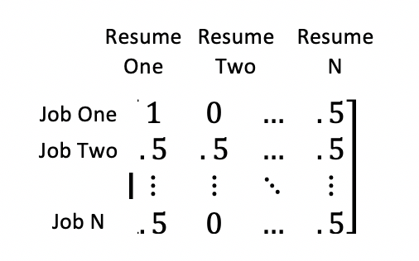
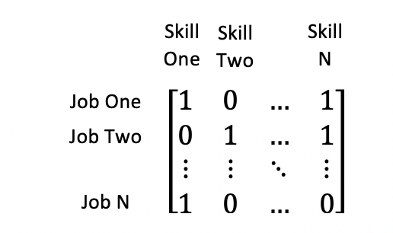
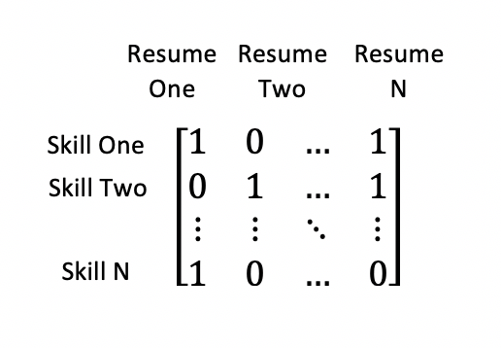
Measuring Mismatch of Job-Requested Skills to Workforce Skills
Once you've found job ads and resumes that matter you can use linear algebra to get a mismatch metric:
=
(Divide by Number of skills in job to normalize)
Notes:
MOTIVATE why you are talking about mismatch.
So we know the employers want these skills, and the potential employees have these other set of skills. How can we compare them? We could look at them individually, like above, but different jobs require different combinations. So we came up with a way to measure this "mismatch"
The explanation here did not make much sense, and I want you guys to focus hard on making it work. It's pretty simple to say we look at every job, and the individual skills it required, and calculate the proportion of the requested skills each candidate has, instead of relying on only matrix algebra. You can still say say this is a table of all skills by all jobs, with a 1 whenever a job requests a skill. Then this is the same, but for resume skills instead of job skills. Then we multipled. So mismatch is the proportion of skill requested by a job that a candidate can provide.
Let's say it requires 5 skills. We then compare the skills listed in the resume of each candidate to those 5 skills. Here, Resume one has 2 of the 5 skills—so 40% of the requested skills, so Resume 1's mismatch score on Job 1 is .4. We repeat for each resume and each job, giving us a distribution of mismatch from 0 to 1 for each job ad.
Put this on a white background, looks bad with white of photos.
Explain both matrix algebra and practical example.

Slide 68
Overall Mismatch: Critical Care Nurses in Richmond and Blacksburg
Match Scores for Richmond
Match Scores for Blacksburg
Match score
Match score
0.01-0.33
0.34-0.66
0.67-1.0
0.01-0.33
0.34-0.66
0.67-1.0
Job ads (sorted by median match)
Job ads (sorted by median match)
Notes:
This is another slide that needs to get practiced
Up the size of all labels
No axis on histogram
Use same scale
Give example, showing each row is a job and these are three bars—the proportion of candidates whose match scores fall into each of the three bins. That is, the proportion of their applicants that meet 1/3 or less of the criteria, ½-2/3, and 2/3 to all. Pick one that has entries in all three columns.

Slide 69
In-Demand Skills: Critical Care Nurses in Richmond and Blacksburg
Impact of Training on Match Scores: Richmond
Impact of Training on Match Scores: Blacksburg
Greater than expected
Greater than expected
Impact of training on average match
Impact of training on average match
As expected
As expected
Less than expected
Less than expected
Percent of ads calling for skill
Percent of ads calling for skill
Notes:
This graph will show you this. X axis means this: further to the right = more of this. Y axis means that: higher up means more of that. If you look at our four core skills for critical care nurses, NICU is the standout.
Howwwwwww to talk about 1:1 (just show the damn slanty lines)
Two ways skills can be important
This is WAY TOO MUCH to unpack in one slide. Each graph should be one of these (given the size). The 9 quadrants is too much—stick with the 4 ones that matter most (corners).
Add in y axis units and up ticks on x-axis
Explain your axes then explain what each corner quadrant shows, and use red in critical areas instead of purple all over to highlight where focus for education and on-the-job training needs to be—then pitch to Sarah

